Slide 1


Bank CRM Analysis
Power BI Project By Chandan Kumar
Tools Used – Power BI Desktop, MySQL Workbench, MS-Office
Batch – Professional certificate course in data science - December 2024
Platform – Newton School
Date – 13 June 2025

Slide 2

Agenda
Introduction
Problem Statement
Data Overview (Schema)
Metrics and their Insights
Dashboard Snippets
Challenges Faced
Conclusion
Recommendations

Slide 3


Introduction
Welcome to the presentation on customer relationship management in the banking sector. As the analytical CRM specialist for the bank, I've been tasked with extracting insights from diverse customer datasets to reduce churn, improve service, and boost satisfaction.
Throughout this session, we'll explore customer demographics, transaction details, exit records, and active profiles. Our goal? To uncover valuable insights that drive strategic decisions and foster lasting customer relationships.
Let's dive in and unlock the power of data-driven strategies for customer retention and satisfaction.

Slide 4

Problem Statement
You are an analytical CRM (Customer Relationship Management) specialist hired by a bank to extract meaningful insights from various customer-related datasets. The bank aims to reduce customer churn, improve service delivery, and enhance customer satisfaction. They have provided you with datasets including customer demographics, transaction details, customer exit information, and active customer profiles.

Slide 5
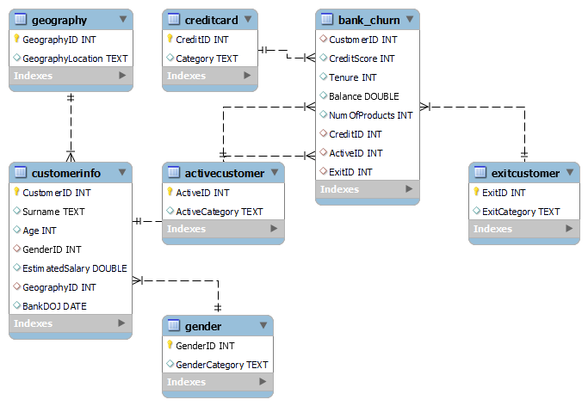
Data Overview (Schema)

Slide 6
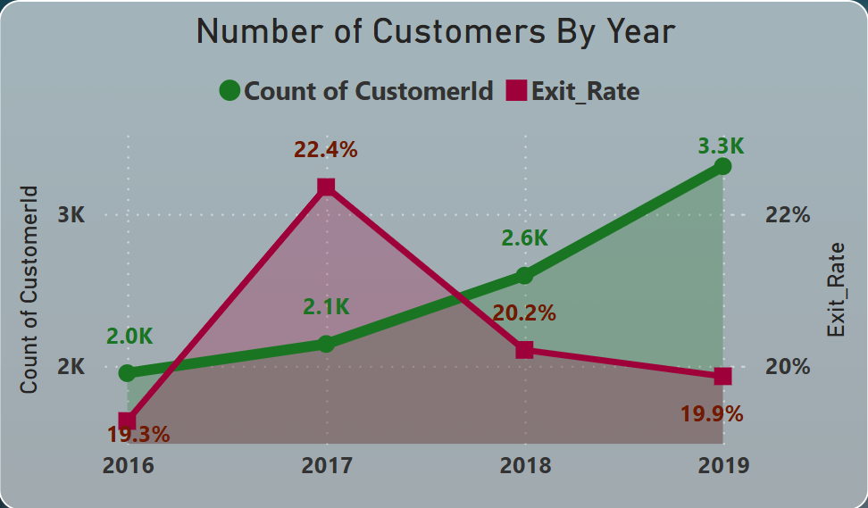
Metric 1: Number of Customers and Churn Rate by Year
Customer count grew steadily from 2.0K (2016) to 3.3K (2019), indicating strong acquisition.
Churn rate peaked at 22.4% in 2017 but improved to 19.9% by 2019, reflecting better retention strategies.
2019 was the most successful year with highest customer gain and lowest churn since 2017.

Slide 7
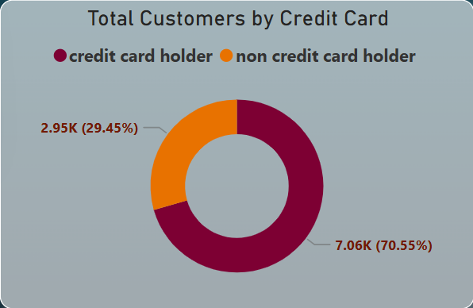
Metric 2a: Number of Customers by Credit Card
Majority (70.55%) of customers are credit card holders, showing strong penetration of credit products in the customer base.
29.45% of customers do not own a credit card, highlighting a potential segment for targeted marketing or product upselling.
This split suggests a well-established credit card user base, but also an opportunity to boost overall revenue through wider product adoption.

Slide 8
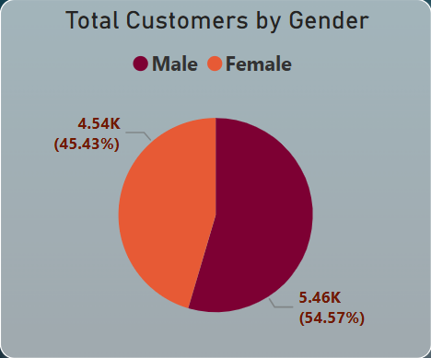
Metric 2b: Number of Customers by Year
Male customers make up 54.57% (5.46K) of the total customer base, forming the slight majority.
Female customers account for 45.43% (4.54K), reflecting a relatively balanced gender distribution overall.
The near-equal split allows for gender-neutral marketing strategies or tailored campaigns to improve engagement from both segments.

Slide 9
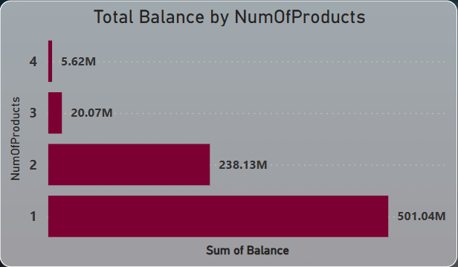
Metric 3a: Total Balance by NumOfProducts
Single-product customers hold the highest balance at ₹501.04M, highlighting their dominant contribution.
As the number of products increases, total balance significantly decreases, with just ₹5.62M for 4 products.
This pattern suggests low multi-product adoption, indicating an opportunity for cross-selling and product bundling strategies.

Slide 10
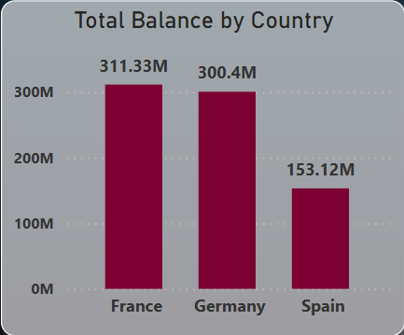
Metric 3b: Total Balance by Country
France leads with the highest total balance at ₹311.33M, indicating strong financial engagement.
Germany closely follows at ₹300.4M, suggesting comparable customer value and financial activity.
Spain significantly lags behind at ₹153.12M, highlighting potential for growth and targeted financial strategies.

Slide 11
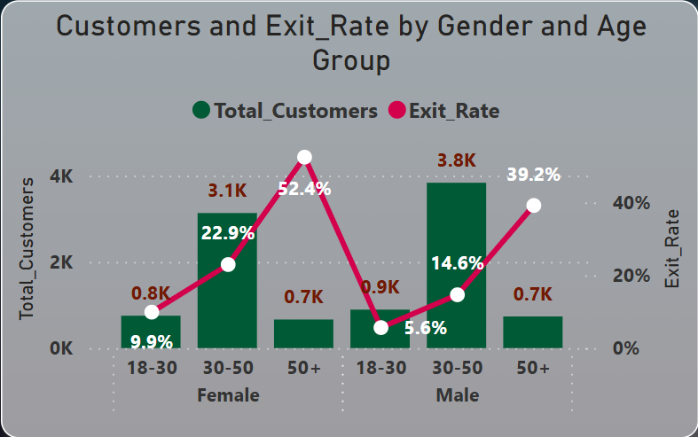
Metric 4: Customers and Churn Rate by Gender and Age-Group
Females aged 50+ have the highest churn risk (52.4%), demanding urgent retention strategies.
Males aged 50+ also show elevated churn (39.2%) despite a small customer base.
Males aged 30–50 form the largest customer segment (3.8K) with moderate churn (14.6%), making them a key target for growth.
Younger customers (18–30) of both genders have the lowest churn (5.6%–9.9%), indicating strong loyalty and long-term potential.

Slide 12
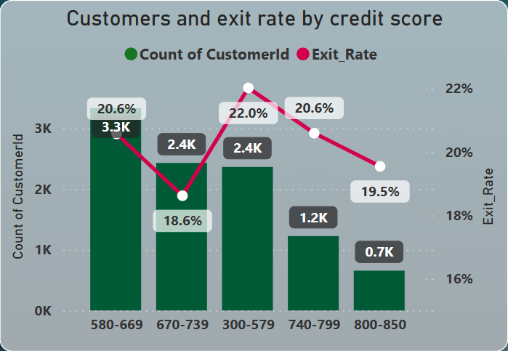
Metric 5: Customers and Churn Rate by Credit Score
Customers with low credit scores (300–579) have the highest churn rate (22%), indicating high risk.
Highest customer volume (3.3K) is in the 580–669 range with a churn rate of 20.6%, slightly above average.
Best retention (19.5%) is seen in the 800–850 score range, though this segment has the lowest customer count (0.7K).
Mid-credit range (670–739) shows lowest churn (18.6%) among larger groups, making it the most stable customer segment.

Slide 13
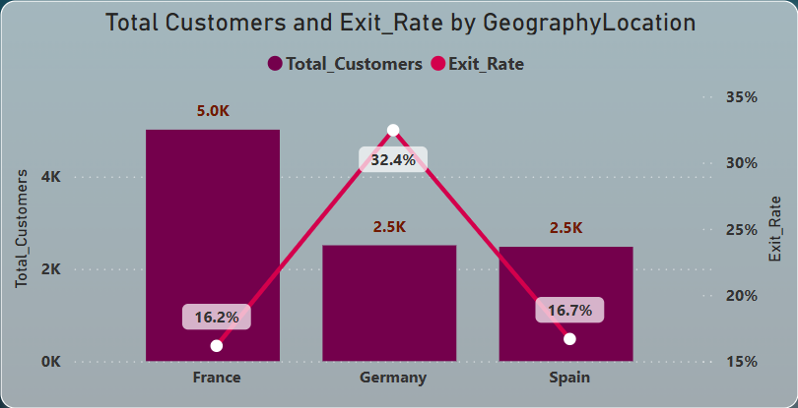
Metric 6: Churn Risk by Country – Geography Insight
Customers with low credit scores (300–579) have the highest churn rate (22%), indicating high risk.
Highest customer volume (3.3K) is in the 580–669 range with a churn rate of 20.6%, slightly above average.
Best retention (19.5%) is seen in the 800–850 score range, though this segment has the lowest customer count (0.7K).
Mid-credit range (670–739) shows lowest churn (18.6%) among larger groups, making it the most stable customer segment.

Slide 14
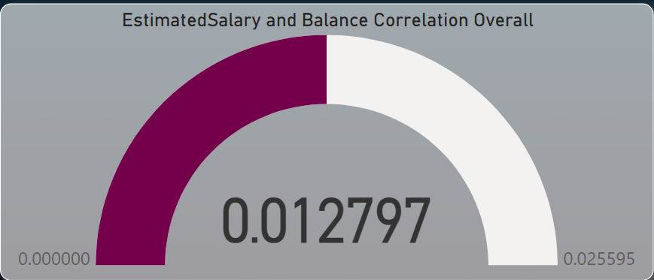
Metric 7: Correlation Insight – Salary vs. Balance
The correlation between Estimated Salary and Balance is very low (0.0128).
This indicates almost no linear relationship, meaning a customer’s salary does not significantly impact their account balance.

Slide 15
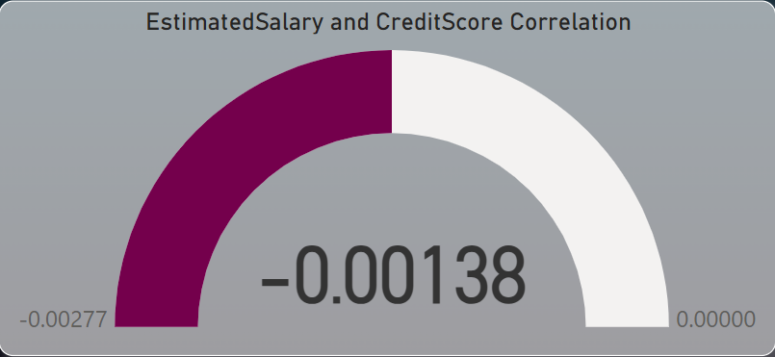
Metric 8: Correlation Insight – Salary vs. Credit Score
The correlation is nearly zero (-0.00138), indicating no significant relationship between a customer's estimated salary and their credit score.
This suggests that higher salaries do not correspond to better credit scores, and vice versa.

Slide 16
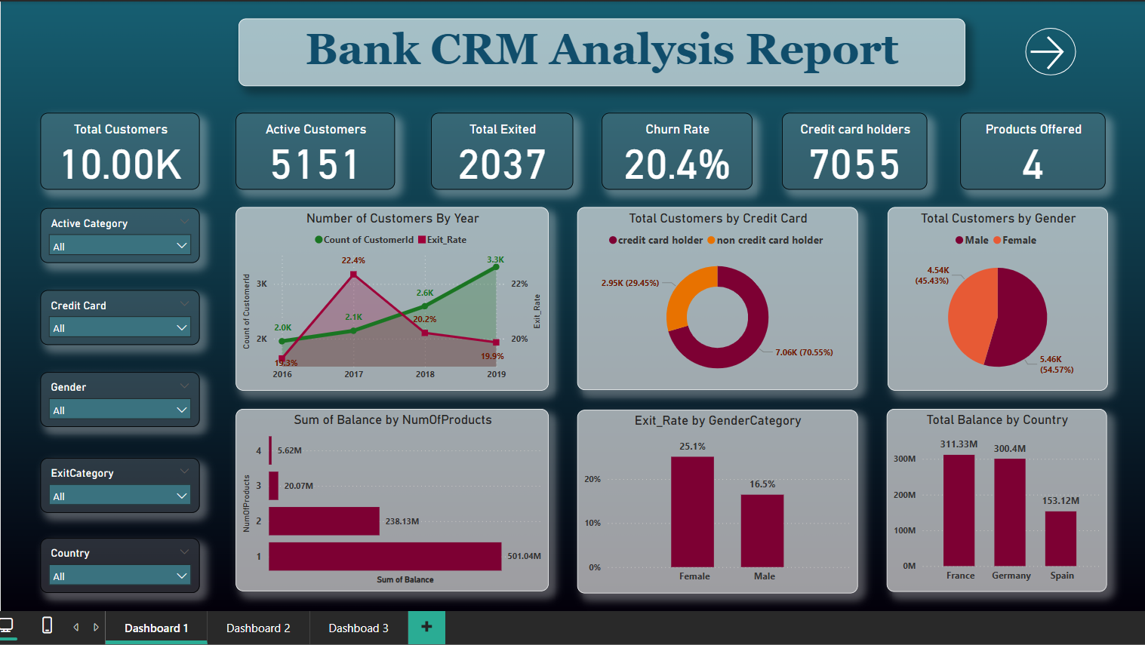
Dashboard Snippets

Slide 17
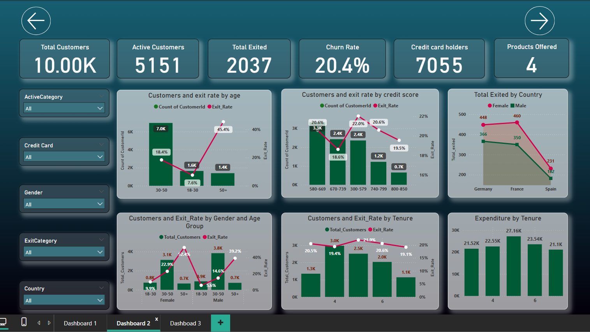

Slide 18
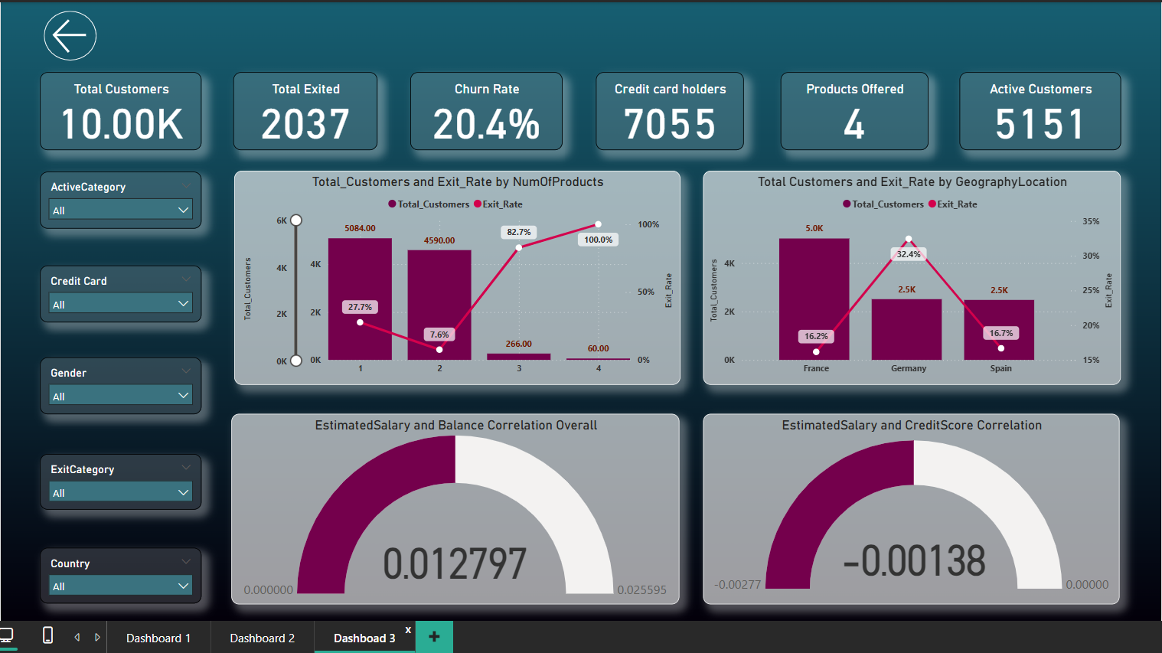

Slide 19
Challenges Faced
Limited Data Availability: Obtaining comprehensive datasets for analysis proved challenging, since several crucial variables were absent, which limited the breadth of insights that could be obtained.
Technical Restrictions: Due to the limitations of the technologies at hand, it was difficult to carry out intricate analyses or put sophisticated machine learning algorithms into practice.
Complexity of Analysis: Understanding complex connections and trends in the data was necessary for analyzing customer behavior and forecasting churn, which called for advanced analytical techniques and cautious result interpretation.
Overcoming Obstacles: Overcoming these obstacles required using iterative problem-solving strategies, making the most of the resources at hand, and cultivating a resilient and adaptive attitude to deal with uncertainty.

Slide 20
Conclusion
Churn is highest among females 50+ (52.4%) and Germans (32.4%), needing focused retention strategies.
Young customers (18–30) and those with mid credit scores (670–739) show the lowest churn, indicating loyalty.
France has the strongest market presence with high customer volume and low exit rate (16.2%).
Most customers hold only 1 product but contribute the highest balance, highlighting upsell potential.
Non-credit card holders (29.45%) are a key group for cross-sell strategies.
Salary has no correlation with credit score or balance, suggesting it's not a useful predictor for churn or financial behavior.

Slide 21
Recommendations
Focus retention efforts on females aged 50+ and German customers, as they show the highest churn rates.
Launch personalized upselling campaigns for single-product holders and non-credit card users to deepen engagement.
Strengthen loyalty programs for the 30–50 male segment, the largest and moderately stable group.
Promote and reward behavior seen in mid-credit score groups (670–739) to maintain their low churn.
Salary-based targeting should be avoided, as salary has minimal impact on both balance and credit score.
Prioritize France and Spain for expansion, as both show strong customer loyalty with manageable churn rates.

Slide 22



